Slide 1
Introduction to Big Data
-Dr. Shaik Fathimabi

Slide 2
Objectives:
Introduction to Big Data
Big Data Definition
Characteristics of Big Data
Data in warehouse & Data in hadoop
Why Big Data is important?
Patterns for Big Data development.

Slide 3
Introduction to Big Data
Big Data applies to information that can’t be processed or analyzed using traditional processes or tools.
Increasingly, organizations today are facing more and more Big Data challenges. They have access to a wealth of information, but they don’t know how to get value out of it because it is sitting in its most raw form or in a semistructured or unstructured format; and as a result, they don’t even know whether its worth keeping.
An IBM survey found that over half of the business leaders today realize they don’t have access to the insights they need to do their jobs.

Slide 4
Big Data era is in full force today because the world is changing
Instrumentation: Through instrumentation we are able to sense more things and store.
Communications technology: things and people are becoming increasingly interconnected and not just some of the time, but all of the time.
Intelligence: Because small integrated circuits are now so inexpensive and we are able to add intelligence to almost everything.
Smart Planet: The world is now instrumented, interconnected and intelligent.

Slide 5
Characteristics of Big Data
Volume
Variety
Velocity
Volume of Data(Can there be enough?)
The sheer volume of data being stored today is exploding.
In the year 2000, 800000 petabytes of data were stored in the world. Expectation that the data will reach 35zettabytes by 2020.
Twitter alone generates more than 7 terabytes of data every day, facebook 10 terabytes and some enterprises generates terabytes of data every hour of every day of the year.

Slide 6
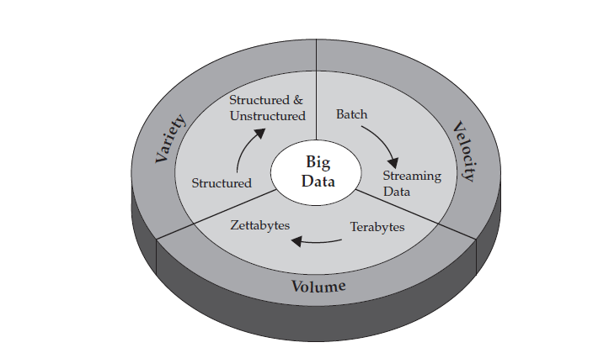

Slide 7
We used to keep a list of all the data warehouse we knew that surpassed a terabyte almost a decade ago, things have changed when it comes to volume.
We store everything: environmental data, financial data, medical data, surveillance data etc.
Big Data: organizations are facing massive volumes of data. Organizations that don’t know how to manage this data are overwhelmed by it. But the opportunity exists, with the right technology platform, to analyze almost all of the data to gain a better understanding of your business, your customers and the marketplace.

Slide 8
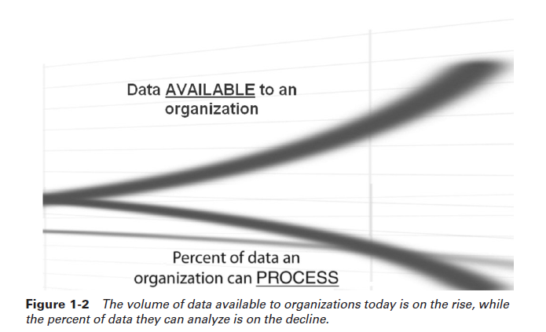
The conversation about data volumes has changed from TB to PB with an inevitable shift to ZB, and all of this data can’t be stored in your traditional systems.

Slide 9
Variety(Is the spice of Life)
The volume associated with the Big Data brings challenges for data centers trying to deal with it: i.e variety.
With the explosion of sensors, smart devices as well as social collaboration technologies, data in an enterprise has become complex, because it includes not only traditional relational data, but also raw, semi-structured and unstructured data from web pages , web log files, search indexes, social media forums, e-mail, documents, sensor data from active and passive systems and so on.
Traditional systems can struggle to store and perform the required analytics to gain understanding from the contents of these logs because much of the information being generated doesn’t lend itself to traditional database technologies.
Variety represents all types of data(structured, semi-structured and unstructured) as part of decision making and insight process.
Traditional analytics platforms can’t handle variety.
Relational databases spent more time on just 20 percent of the data which suits for schemas where as 80% of world’s data is semi-structured and unstructured.

Slide 10
Twitter data structure is JSON format- but the actual text is not structured. Video and picture images aren’t easily or efficiently stored in a relational database, certain event information can dynamically change.
Velocity of Data(How fast is fast?)
The sheer volume and variety of data we collect and store has changed, so the velocity at which it is generated and needs to be handled.
How quick the data is arriving and stored, and its associated rates of retrievals.
Today’s enterprises are dealing with PB of data instead of TB, and the increase in RFID sensors and other information streams has led to a constant flow of data at a pace that has made it impossible for traditional systems to handle.
Big Data scale streams computing is a concept that IBM has been delivering on for some time and serves as a new paradigm for Big Data problem. In traditional processing u can think of running queries against relatively static data.
Dealing effectively with Big Data requires that u perform analytics against the volume and variety of the data while it is still in motion, not just after it is at rest.

Slide 11
Data in the warehouse and Data in Hadoop
Traditional warehouses are mostly ideal for analyzing structured data from various systems and producing insights with known and relatively stable measurements. On the other hand ,Hadoop based platform is well suited to deal with semi-structured and unstructured data. That doesn’t mean that hadoop is not suited for structured data.
In warehouse the data goes through a lot of rigor to make it into the warehouse. Builders and consumers of warehouse have it etched in their minds that the data they are looking at in the warehouse must shine w.r.t quality, it’s cleaned up before it is ready for analysis. This is an expensive process.
In contrast, Big Data repositories rarely undergoes the full quality control rigors of data being injected into a warehouse, because not only prepping data for some of the newer analytic methods characterized by Hadoop use cases cost prohibitive.
Hadoop data isn’t trusted.
Hadoop based repository scheme where the entire business entity is likely to be stored and the fidelity of the tweet, transaction and more is kept intact.

Slide 13
A big Data platform lets u store all of the data in its native business object format and get value out of it through massive parallelism on readily available components.
Why is Big Data Important?
Big Data Principles:
Big Data solutions are ideal for analyzing not only raw structured data, but semi-structured and unstructured data from a wide variety of sources.
Big Data solutions are ideal when all, or most, of the data needs to be analyzed vrs a sample of the data.
Big Data solutions are ideal for iterative and exploratory analysis when business measures on data are not predetermined.
Solving Information Management Challenges using Big Data Technologies:
it is the reciprocal of the traditional analysis paradigm appropriate for the business task at hand.
Big Data is well suited for solving information challenges that don’t natively fit within a traditional relational database approach for handling the problem at hand.

Slide 14
Big Data Use Cases:
Patterns for Big Data Deployment
IT for IT log Analytics
Log analytics is a common use case for Big Data projects.
Enterprises have lots of data exhausts, and its pretty much pollutant if its just left around for a couple of hours or days in case of emergency & simply purged.
Log Analytics is actually a pattern that IBM established after working with a number of companies, including some large financial service sector companies.
2. The fraud detection pattern

Slide 15
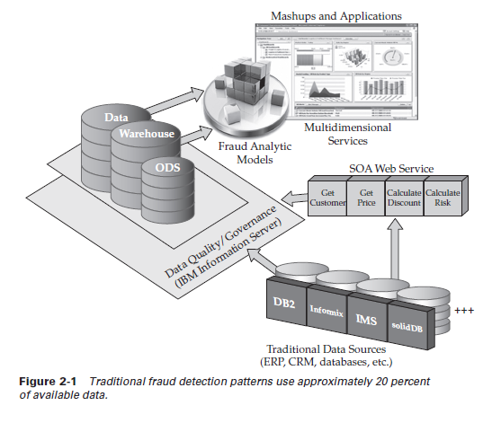

Slide 16
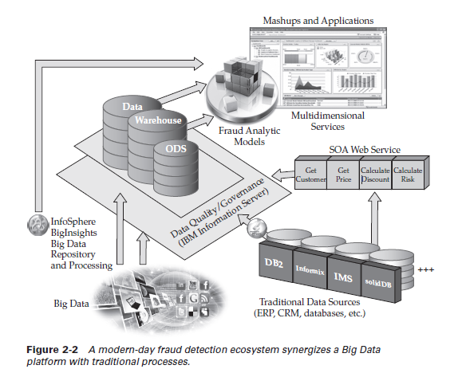

Slide 17
3. Credit Card Fraud Detection
Problem statement:
A US national bank which has a revenue of $10 billion, is losing about 2% of its revenue i.e $20 million, due to fraudlent card transactions.
Objective:
Identify whether the requested transaction is fraudlent or not.
To identify potential fraud in a transaction is challenging as time needed to complete the transaction is merely few seconds.
Data needs to be processed in real time.
4. Sentiment Analysis
Objective :
Identify the orientation of opinion in a piece of text (blogs, user comments, review websites, community websites etc)
Sentiment analysis provides substance behind social data.
It processes language and understand consumer feelings and attitudes towards brands or topics in online conversations.
If a company is launching a new product, using sentiment analysis we can identify user’s opinion about the same, based on the user’s opinion product can be improved.
It enables business to make early decision rather than wait for sales report.

Slide 18
5. Retail – Data Processing
6. Market Basket Analysis
7. Aadhar Project by govt of india
8. Weather Forecasting
9. Healthcare Analysis
I10. IT Infrastructure optimization.

